Slide 1


Cryvesto 3.0 Lights Camera Action
Presenter Dana Hayes
Notes:
Hello Class, My name is Dana Hayes, Chief Product Officer, and would like to introduce Cryvesto 2.0.

Slide 2





Agenda
Intro: Executive Summary & Project Goals
Product Demonstration
Data
The Selected Model
Results & conclusion or Application
Future Next Steps
Notes:
Elaborate from the screen

Slide 3




Intro & Proposal
Team Cryvesto 3.0 constructs a LCA GUI for retail investors & fans to invest in their favorite entertainment themes, currently accessible to only HNW and IBs
We believe that using FinTech we can bring a larger group to pool additional funds for financing and increase revenue streams by closely tracking market trends
Able to attract a younger generation using new technology for their preferred investible entertainment

Slide 4

Executive Summary
A novel enterprise to develop investment opportunities through FTs & NFT smartcontracts for a multi-media production company.
CryVesto PE provides an innovative approach to fund multi-media company "Light-Camera-Action"(LCA) to produce projects for theme centered fan entertainment
Provide investment opportunities to both retail fans and HNW alike to defragment the global entertainment industry
Utilizing our FinTech expertise we’re providing a gateway to bring fans closer to their favorite artists and entertainment themes thru investment
By attaching tangible IP assets with production projects value is quantifiable for both FTs in “BollyCoins” and NFTs
Notes:
CryVesto PE seeks an innovative approach to address funding using the blockchain and smartcontracts for multi-media company "Light-Camera-Action"(LCA) to produce movies; games; NFTs; education & entertainment material in the multi-verse and AR & VR platforms for theme centered fan entertainment. Our goal is to expand investment opportunities to financiers and retail fans internationally to defragmentize the global entertainment industry.
Company’s Role and Strength: Utilizing our Fintech expertise, we bring closer proximity between creators, entertainers and fans to passionately support their favorite artists and entertainment themes. This provides monetary support from a larger group of investors who ordinarily wouldn’t be able to participate in financing entertainment projects. Our strength is creating global opportunities for fans who want to back their favorite artists and entertainment themes, but get a return on their money spent by investing to complement their amusement.
Need/Problem: With the growing entertainment activity on the internet, and the increasing interest in cryptocurrency and NFTs we are addressing a need to bridge a gap with FinTech technologies to support a wider market of investors.
Unique Solution: By attaching tangible IP assets with production projects, we can bring quantifiable returns to both fungible tokens(FTs) and non-fungible tokens(NFTs) in the LCA environment..
Resources:
Competition: Currently we do not see any competition utilizing FinTech in this matter to finance an entertainment company using cryptocurrency & NFTs, while providing investment opportunities to fans.
Marketing Strategy: Marketing investment opportunities regionally to prospective fans can provide them with quantifiable returns from various entertainment theme projects previously unavailable. This can attract greater participation from regional fans by providing them opportunities in their favorite project themes and receive future returns in the form of 'Bollycoins'. This allows greater interaction between the studios, entertainers and fans to benefit from the financial returns of each production and enjoy the LCA entertainment ecosystem.
Conclusion: Including a broader audience of interested fans at large globally, we’re migrating the entertainment industry from regional isolation in its respective territorial markets to a more inclusive global intercultural entertainment company. By including and addressing the needs of diverse cultures in entertainment, LCA also diversifies its portfolio revenue streams for greater chances of success and profits

Slide 5
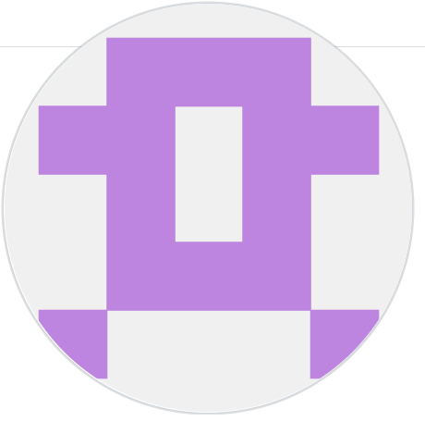
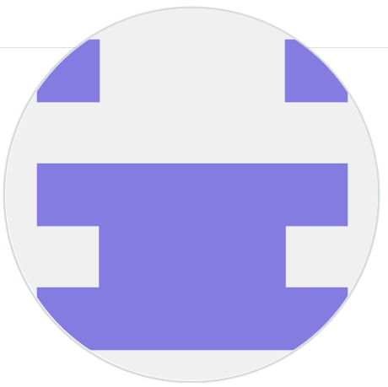
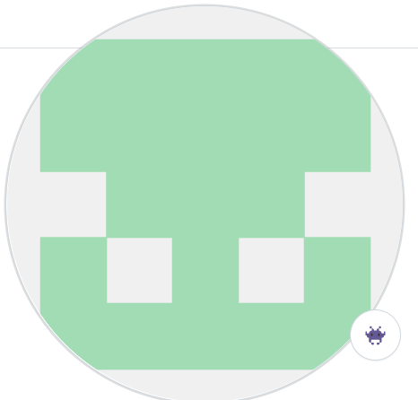
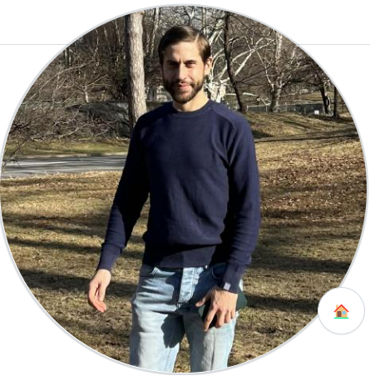
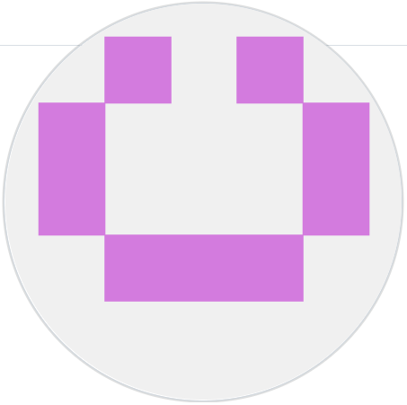

Team Cryvesto
Anna Joltaya
Ashok Pandey Chief Computer Scientist
Dana Hayes Chief Future Officer
Rensley Ramos
Chief R & D Officer
Chief Marketing & Sales Executive
Anusha Sundararajan
Carlos A. Guerra
Chief of Product Development
Chief Technology Officer
Notes:
Now to introduce the Cryvesto Team…

Slide 6
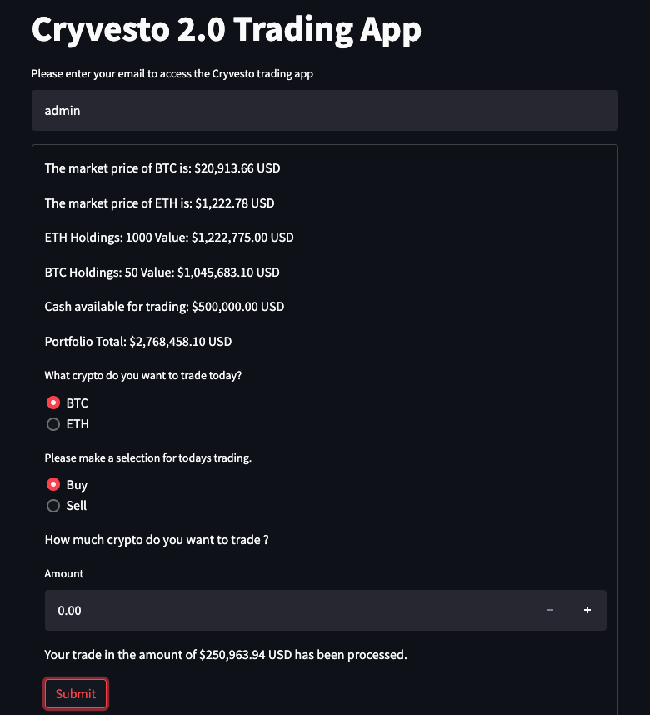

Lights Camera Action GUI using Streamlit

Slide 7

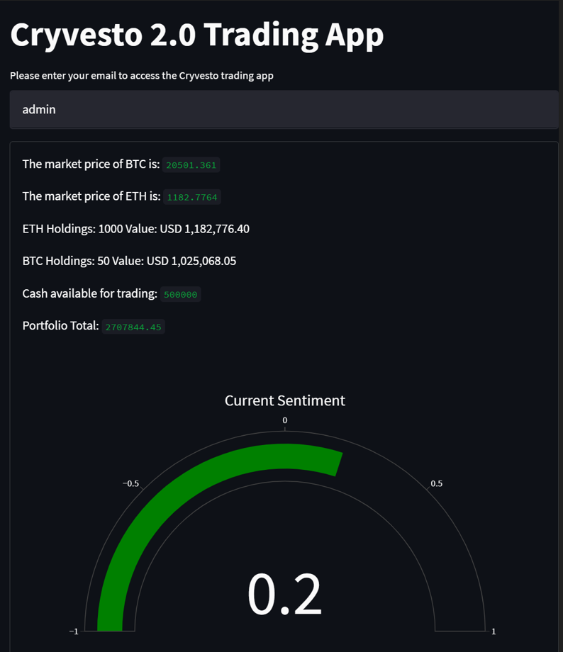
Lights-Camera-Action GUI
NFT Registration selection:
to demonstrate the NFT/FT* registration process as well as, the creation of the campaign target
* FT is BollyCoin
2. Movie Project selection:
To demonstrate the investor side of selecting a movie project and choosing to invest in it
Notes:
As presented by Anusha, we used Streamlit app to show and get our project running
We created two separate tabs
We used a combination of Streamlit code together with creating functions which presented some difficulties:
difficulty lay in properly connecting the smart contracts and imbedding them into the python code.
had to find solutions in getting the correct abi and making correct calls to the solidity code & back to the streamlit code that acted as our front end
there was a lot of consideration given in the placement of where each function had to be
in the future we wish to lean away from streamlit to a more reliable platform & that causes less issues

Slide 8

Techniques to Test & Evaluate Our Code
Need for both Fungible tokens & NFTs
ERC20 and 721 standards
ERC 1155 standard for both types of tokens
Inter Planetary File System (IPFS) utilized to store NFT images and metadata.
ERC 2981 Royalties & dividends contracts and other apps were reviewed.
Notes:
Ashok’s Script
As you must have observed that we need both NFTs and Fungible Tokens for raising funds. That would require ERC20 and 721. Instead, we chose to use the more cost-effective ERC1155 which combines the functions of two standards into one. On one hand it was easier, but on the other we had to develop a number of functions in Solidity to conduct the transactions. We also used IPFS to store the NFTs. On the flip side, after the movie is produced, the realized Profits are disbursed in the form of BOLLYCOINS, our company’s cryptocurrency, be it Dividends, Royalties or just rewards. Our team members also looked at standards like EIP 2981 for Royalty treatment. Due the lack of time and increased complexity, the Dividend module is yet to be integrated into the code.
We faced a number of challenges due to lack of available functions in the 1155 contract, and we found Streamlit interface to Solidity unreliable – it may very well be due to lack of experience on our part. But, the blessing in disguise is the fact that we learnt a lot of how to code in Solidity.

Slide 9


LCA’s “BollyCoin” Token
Lights-Camera-Action Productions Inc. fungible token is the currency of the LCA ecosystem for investors and loyal fans to invest in production projects and make transactions with NFTs or withdrawals in their HD wallet.
Notes:
The fungible token for ‘Lights-Camera-Action’ MultiMedia Production LLC ecosystem. It provides a medium of monetary exchange within the LCA ecosystem for investors to finance projects and receive dividends or royalties from NFT themed entertainment projects. Creators and artists can also get royalties for their Intellectual Property, as long as they own it. They can also sell the NFT and receive “BollyCoins” and use for other tranactions in the LCA ecosystem.

Slide 10
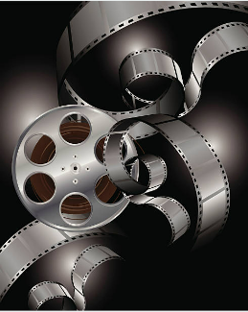
Challenges Faced
Lack of function availability in ERC1155 when compared to ERC20 and 721
Unreliable Streamlit responses to Solidity Interface
Lack of time to diagnose problems and resolve them
Notes:
Ashok’s Script
We faced a number of challenges due to lack of available functions in the 1155 contract, and we found Streamlit interface to Solidity unreliable – it may very well be due to lack of experience on our part. But, the blessing in disguise is the fact that we learnt a lot of how to code in Solidity.

Slide 11
The Cryvesto Approach to Achieve Project Goals
Backtested the models and compared Classification reports with Cumulative Returns
Issues anticipated to tame the model
Placed strategic modifications in the signal coding
Backtested many trial runs with different configurations
Analyzed several Neural Network performance runs
Converted Classification Reports & Charts to pandas for efficiency and avoid the tedious backtesting process of changing parameters and recording
Notes:
During the research and development we encountered many issues relating to different Signal strategies. Found out that the best strategy was the simplest one we chose.

Slide 12

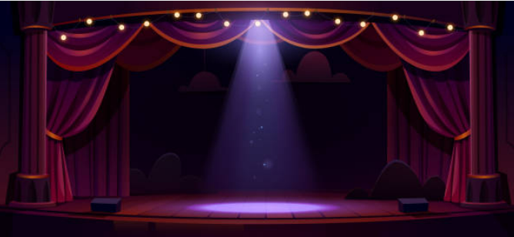
Summary
ERC2981 NFT Royalty Token standard
Optional Royalty payments
ERC4626 Token Vault Standard
Intrinsically interest-bearing tokens
EIP137 Domain Name Service
A single global namespace for all names with a single ‘centralized’ resolver
Benefits:
Cryvesto gets ahead of trends before they occur on the market.
s are executed at the best possible prices
Trades are timed correctly and instantly to avoid significant price changes before volatility increases in the marketplace- adding targeted security.
of trends before they occur on the market.
Trades are executed at the best possible prices
Notes:
Rensley Ramos speaks:

Slide 13

Future Direction
Finalize all the business details
Functionality of business plan & technology integration
Build working mvp and initiate funding round
Notes:
Cater to multiple projects simultaneously •Dividend and Royalty features integrated in Blockchain •HNI or Institutional investor integration on Blockchain •create Reporting tools •After successful fund raising and execution of film projects •Institutional and Retail investments in the company through BOLLYCOIN •Real coin backed by assets and performance of the company

Slide 14
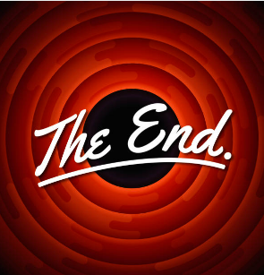


Thank You
Team Cryvesto 3.O
team_cryvesto3.0@cryvesto.com
Cryvesto PE
Notes:
“Thank You for your attention”; and now we’re available for any questions.

